Slide 1
Theorem Proving Tools for Program Analysis SMT Solvers: Yices & Z3 Austin, Texas 2011
Nikolaj Bjørner ², Bruno Dutertre¹, Leonardo de Moura²
SRI International¹, Microsoft Research²

Slide 2
SMT@SRI: Yices
Yices is SRI’s SMT Solver
Freely available for non-commercial use
Multiple platforms are supported (Windows, Mac OS X, Linux)
Backend of other SRI tools (PVS, SAL model checkers)
Two versions exist
Yices 1 is the official system (first release, August 2006)
Yices 2 is an improved version under development (prerelease prototypes are available)
Interface:
Text: both SMT LIB 1.2 + Yices’s own input language
Library API (C/C++)
http://yices.csl.sri.com/

Slide 3

SMT@Microsoft: Z3
Z3 is a new solver developed at Microsoft Research.
Development/Research driven by internal customers.
Free for academic research.
Interfaces:
http://research.microsoft.com/projects/z3
Z3
Text
C/C++
.NET
OCaml

Slide 4
Syllabus
The Logic of SMT solvers
Decidability and Decision Procedures
User Interaction and Guidance
Main Applications

Slide 5
Syllabus
The Logic of SMT solvers Many-sorted first-order logic + background theories.
Decidability and Decision Procedures Ground decision procedures: SAT, Uninterpreted Functions, Linear Arithmetic, Bit-vectors, Algebraic data-types, Arrays – emphasis on scale. First-order quantifiers: decidable fragments, quantifier-elimination, generally undecidable and incomplete – no induction or planning.
User Interaction and Guidance Back-ends inside analysis tools – not end-to-end.
Main Applications Program verification, Symbolic execution, Modeling

Slide 6
The Logic of SMT Solvers

Slide 7
The Logic of SMT Solvers
SMT: Satisfiability Modulo Theories
Input: a first-order formula ϕ over background theory
Output: is ϕ satisfiable?
does ϕ have a model?
Is there a refutation of ϕ = proof of ¬ϕ?
For most SMT solvers: ϕ is a ground formula
Background theories: Arithmetic, Arrays, Bit-vectors, Algebraic Datatypes
Most SMT solvers support simple first-order sorts

Slide 8
Satisfiability Modulo Theories (SMT)
b + 2 = c and f(read(write(a,b,3), c-2)) ≠ f(c-b+1)

Slide 9
Satisfiability Modulo Theories (SMT)
b + 2 = c and f(read(write(a,b,3), c-2)) ≠ f(c-b+1)
Arithmetic

Slide 10
Satisfiability Modulo Theories (SMT)
b + 2 = c and f(read(write(a,b,3), c-2)) ≠ f(c-b+1)
Array Theory
Arithmetic

Slide 11
Satisfiability Modulo Theories (SMT)
b + 2 = c and f(read(write(a,b,3), c-2)) ≠ f(c-b+1)
Uninterpreted Functions
Array Theory
Arithmetic

Slide 12
Satisfiability Modulo Theories (SMT)
b + 2 = c and f(read(write(a,b,3), c-2)) ≠ f(c-b+1)
Substituting c by b+2

Slide 13
Satisfiability Modulo Theories (SMT)
b + 2 = c and f(read(write(a,b,3), b+2-2)) ≠ f(b+2-b+1)
Simplifying

Slide 14
Satisfiability Modulo Theories (SMT)
b + 2 = c and f(read(write(a,b,3), b)) ≠ f(3)

Slide 15
Satisfiability Modulo Theories (SMT)
b + 2 = c and f(read(write(a,b,3), b)) ≠ f(3)
Applying array theory axiom
forall a,i,v: read(write(a,i,v), i) = v

Slide 16
Satisfiability Modulo Theories (SMT)
b + 2 = c and f(3) ≠ f(3)
Inconsistent/Unsatisfiable

Slide 17
SMT formulas - Overview
Simple sorts: Bool - Booleans Int, Real - Integers and Reals BitVec[32], BitVec[n] - Bit-vectors (Array Int Int) - Arrays
Sorted Terms:
(+ (xCoord q) (yCoord q))
Formulas = Terms of Boolean Sort Quantified formulas: (forall ((x Int)) (=> (> x 0) (p x)))

Slide 18






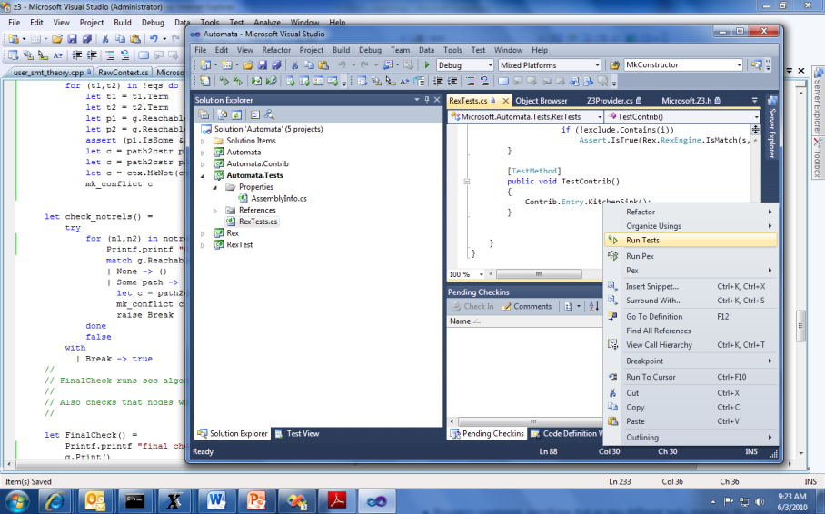


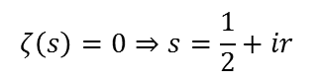
SMT by Example: Job Shop Scheduling
Machines
Tasks
Jobs
P = NP?
Laundry
$$ζ\left(s\right)=0⇒s=\frac{1}{2}+ir$$

Slide 19
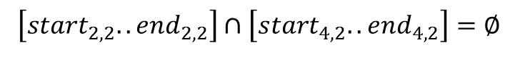
Job Shop Scheduling
Constraints:
Precedence: between two tasks of the same job
Resource: Machines execute at most one job at a time
3
1
2
4
$$\left[start_{2,2}..end_{2,2}\right]∩\left[start_{4,2}..end_{4,2}\right]=∅$$

Slide 20
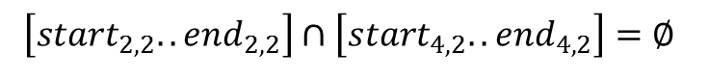
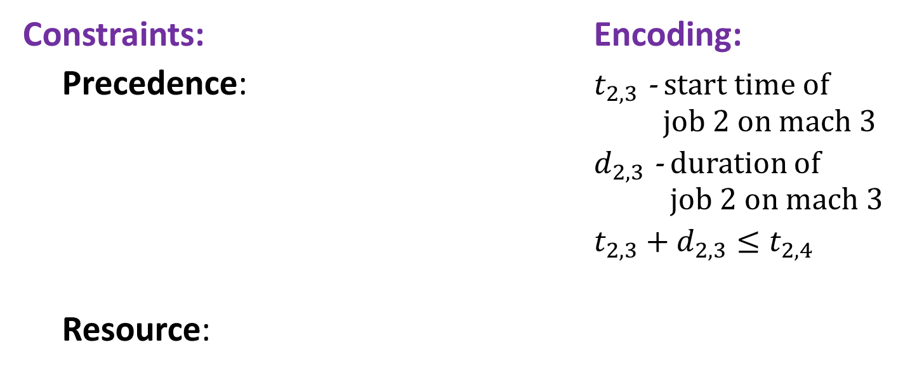
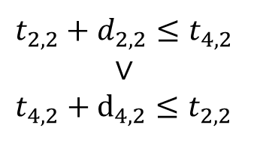
Job Shop Scheduling
Constraints: Encoding:
Precedence: $t_{2,3}$ - start time of job 2 on mach 3
$d_{2,3}$ - duration of job 2 on mach 3
$t_{2,3}+d_{2,3}≤t_{2,4}$
Resource:
3
1
4
2
Not convex
$$t_{2,2}+d_{2,2}≤t_{4,2}$$
$$∨$$
$$t_{4,2}+d_{4,2}≤t_{2,2}$$
$$\left[start_{2,2}..end_{2,2}\right]∩\left[start_{4,2}..end_{4,2}\right]=∅$$

Slide 21
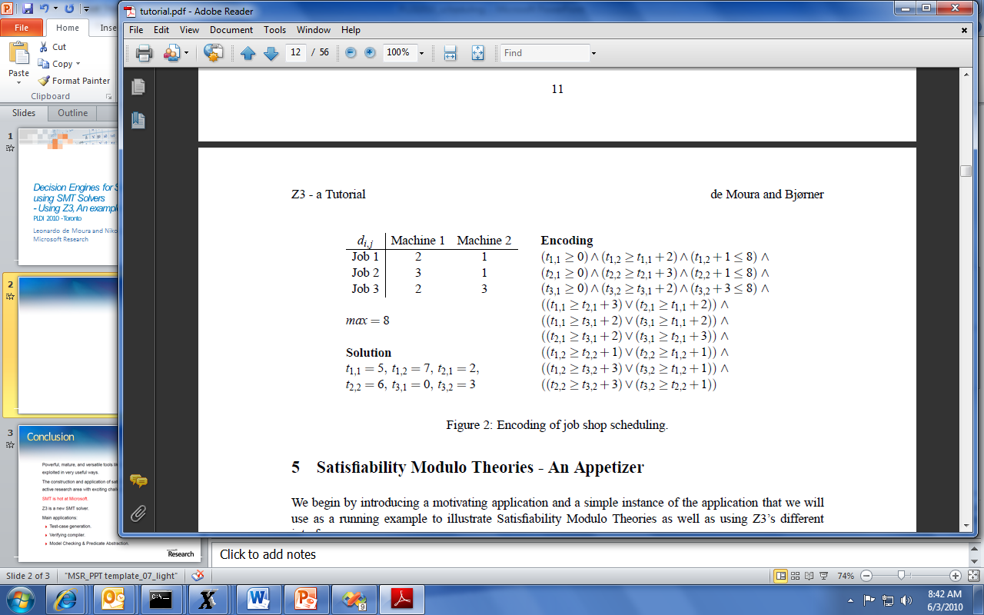
Job Shop Scheduling

Slide 22
Job Shop in SMT2
Start Z3 using smt-lib mode in interactive (/si) enable models (/m).
Z3.exe /smt2 /is /m
Optionally specify the logic. The benchmark is going to use Integer Difference Logic and use the a solver for difference logic
(set-logic QF_IDL)
(declare-fun t11 () Int)
(declare-fun t12 () Int)
(declare-fun t21 () Int)
(declare-fun t22 () Int)
(declare-fun t31 () Int)
(declare-fun t32 () Int)
Declare constants that are going to be used in the problem.
Constants are functions that don’t take any arguments.

Slide 23
Job Shop in SMT2
Add the precedence constraints
(assert (and (>= t11 0) (>= t12 (+ t11 2)) (<= (+ t12 1) 8)))
(assert (and (>= t21 0) (>= t22 (+ t21 3)) (<= (+ t22 1) 8)))
(assert (and (>= t31 0) (>= t32 (+ t31 2)) (<= (+ t32 3) 8)))

Slide 24
Job Shop in SMT2
Add the resource constraints
(assert (or (>= t11 (+ t21 3)) (>= t21 (+ t11 2))))
(assert (or (>= t11 (+ t31 2)) (>= t31 (+ t11 2))))
(assert (or (>= t21 (+ t31 2)) (>= t31 (+ t21 3))))
(assert (or (>= t12 (+ t22 1)) (>= t22 (+ t12 1))))
(assert (or (>= t12 (+ t32 3)) (>= t32 (+ t12 1))))
(assert (or (>= t22 (+ t32 3)) (>= t32 (+ t22 1))))

Slide 25
Job Shop in SMT2
(check-sat)
(model)
Check satisfiability of the assertions
Display the model
("model" "t11 -> 5
t12 -> 7
t21 -> 2
t22 -> 5
t31 -> 0
t32 -> 2")

Slide 26
SMT2 Brief Sketch
(declare-fun id (sort*) sort) declare function
(define-fun id ((id sort)*) sort term)
define an expression shorthand
(assert term) assert formula
(check-sat) check satisfiability of assertions
(push [number]) push 1 (or number) scopes
(pop [number]) pop 1 (or number) scopes
(get-info model) model from satisfied assertions

Slide 27
SMT2 Brief Sketch
term ::= id
| number
| (id term+)
| (forall (id sort)+ term)
sort ::= id | (id sort+)
id ::= and | or | => | + | - | * | …| token | …

Slide 28
Quantifiers – many approaches
Heuristic quantifier instantiation
Combining SMT with Saturation provers
Complete quantifier instantiation
Decidable fragments
Model based quantifier instantiation

Slide 29
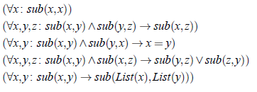
Quantifiers
Example: Single inheritance subtyping
(declare-sort Type)
(declare-fun subtype (Type Type) Bool)
(delcare-fun List (Type) Type)
(assert (forall (x Type) (subtype x x)))
(assert (forall (x Type) (y Type) (z type)
(=> (and (subtype x y) (subtype y z))
(subtype x z))))
(assert (forall (x Type) (y Type)
(=> (and (subtype x y) (subtype y x))
(= x y))))
(assert (forall (x Type) (y Type) (z type)
(=> (and (subtype x y) (subtype x z))
(or (subtype y z) (subtype z y)))))
(assert (forall (x Type) (y Type)
(=> (subtype x y)
(subtype (List x) (List y)))))

Slide 30
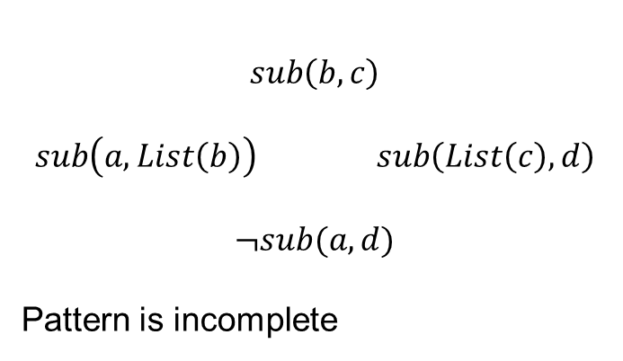
Quantifiers
Example: Single inheritance subtyping
(assert (forall (x Type) (y Type)
(=> (subtype x y)
(subtype (List x) (List y)))
:pat {(subtype (List x) (List y)) }
)
)
$$sub\left(b,c\right)$$
$$sub\left(a,List\left(b\right)\right) sub\left(List\left(c\right),d\right)$$
$$¬sub(a,d)$$
Pattern is incomplete

Slide 31
Quantifiers
Example: Single inheritance subtyping
(assert (forall (x Type) (y Type)
(=> (subtype x y)
(subtype (List x) (List y)))
:pat {(subtype x y) }
)
)
(=> (subtype a b) (subtype (List a) (List b)))
(=> (subtype (List a) (List b)) (subtype (List (List a)) (List (List b))) )
… matching loop

Slide 32
Quantifiers
Example: Single inheritance subtyping
(assert (forall (x Type) (y Type)
(=> (subtype x y)
(subtype (List x) (List y)))
:pat {(List x) (List y) }
)
)
Multi-pattern
☺ Terminates:
depth of new terms is bounded
☹ Expensive:
Quadratic
Instantiated for every pair of (List a) and (List b) created during search
.. But transitive closure is worse – it is cubic.

Slide 33
Decidability and Decision Procedures

Slide 34
Satisfiability Modulo Theories (SMT)
Is formulaϕ satisfiable modulo theory T ?
SMT solvers have specialized algorithms for T

Slide 35
Little Engines of Proof
An SMT Solver is a collection of
Little Engines of Proof
CS359: Little Engines of Proof Shankar et al

Slide 36
Little Engines of Proof
An SMT Solver is a collection of
Little Engines of Proof
Examples:
SAT Solver
Equality solver
Arithmetic, Array, Bit-vector, data-type solvers

Slide 37
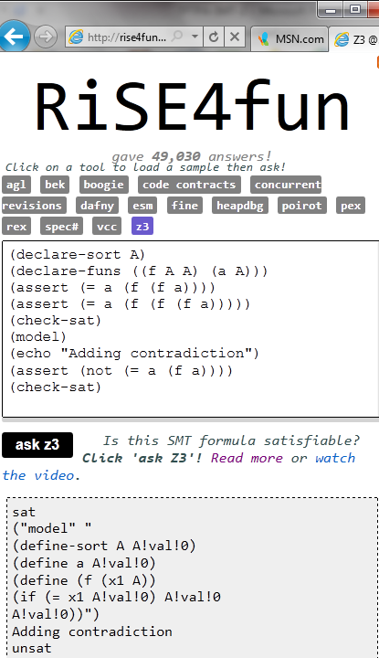
Theories
Uninterpreted functions
Arithmetic (linear)
Bit-vectors
Algebraic data-types
Arrays
User-defined

Slide 38
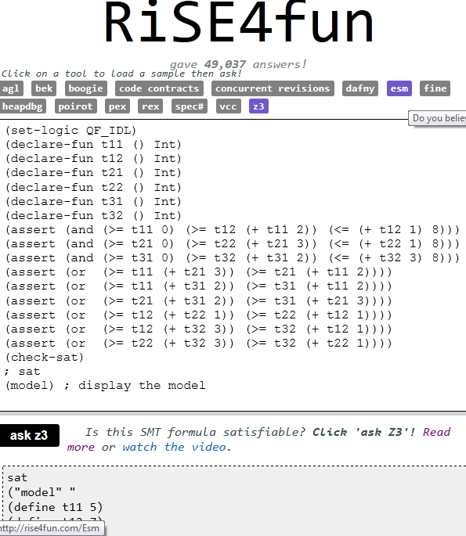
Theories
Uninterpreted functions
Arithmetic (linear)
Bit-vectors
Algebraic data-types
Arrays
User-defined

Slide 39
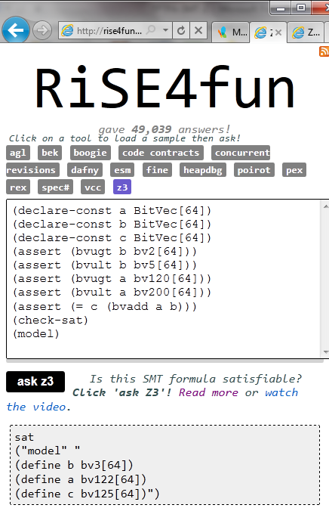
Theories
Uninterpreted functions
Arithmetic (linear)
Bit-vectors
Algebraic data-types
Arrays
User-defined

Slide 40
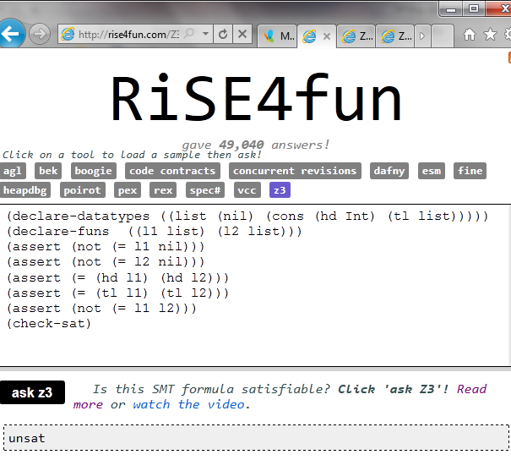
Theories
Uninterpreted functions
Arithmetic (linear)
Bit-vectors
Algebraic data-types
Arrays
User-defined

Slide 41
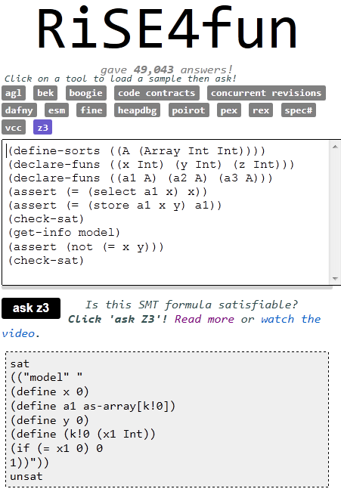
Theories
Uninterpreted functions
Arithmetic (linear)
Bit-vectors
Algebraic data-types
Arrays
User-defined

Slide 42
User-interaction and Guidance

Slide 43
Interaction models
Text: SMT-LIB, SMT-LIB2, Native Yices (high-level), Native Z3 (low-level), Simplify
Programmatic APIs: C, Ocaml, .NET, LINQ,

Slide 44
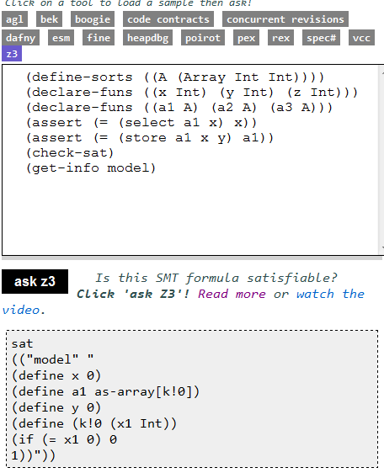
Interaction
Logical Formula
Sat/Model

Slide 45
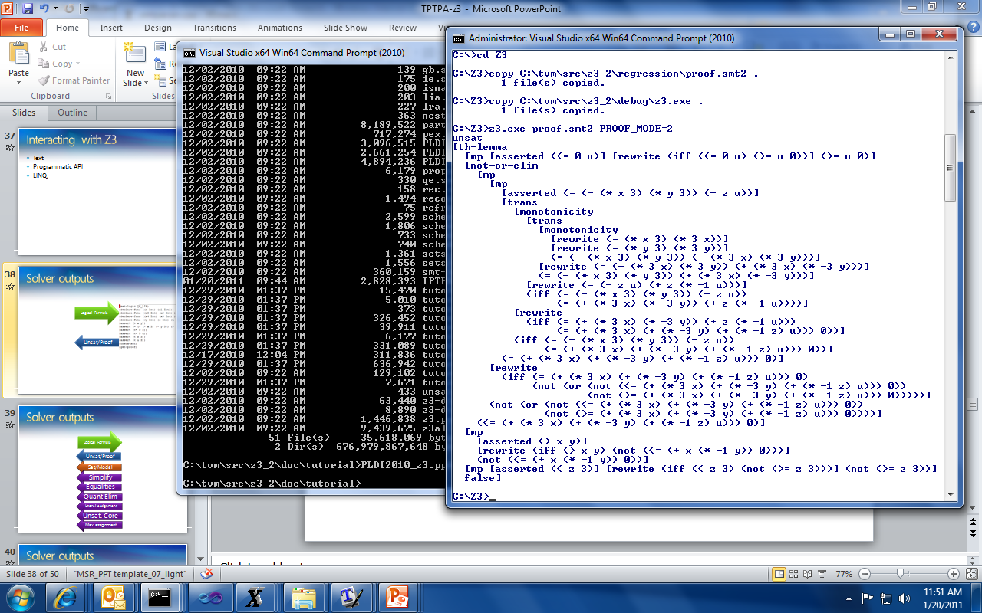
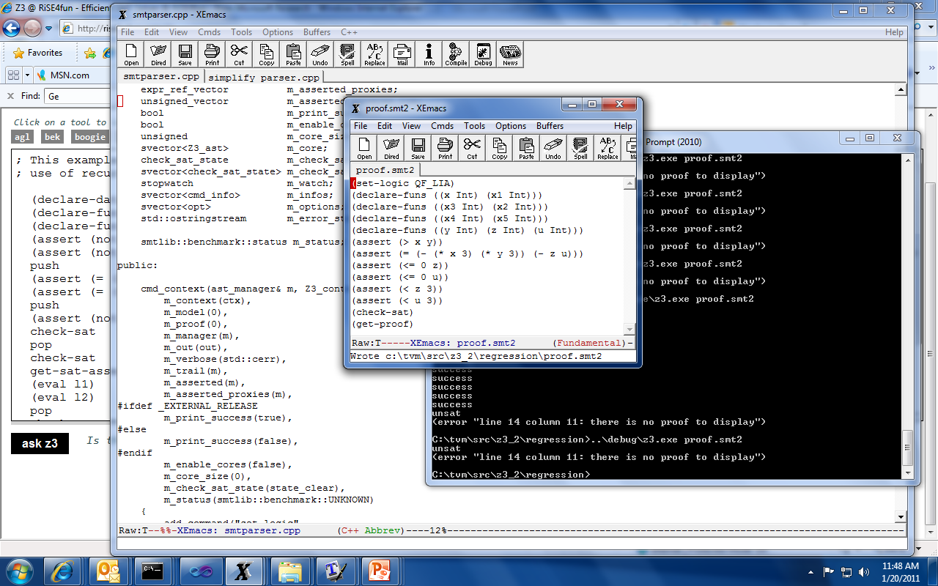
Interaction
Logical Formula
Unsat/Proof

Slide 46
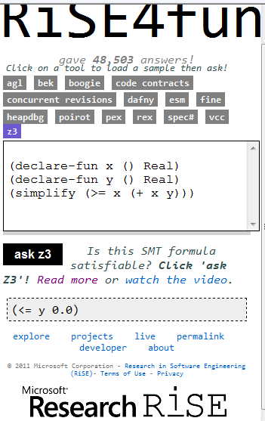
Interaction
Logical Formula
Simplify

Slide 47
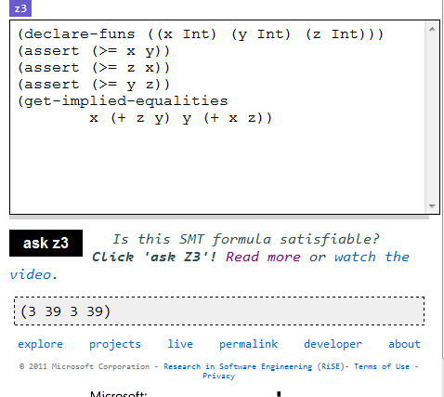
Interaction
Logical Formula
x and y are equal
z + y and x + z are equal
Implied
Equalities

Slide 48
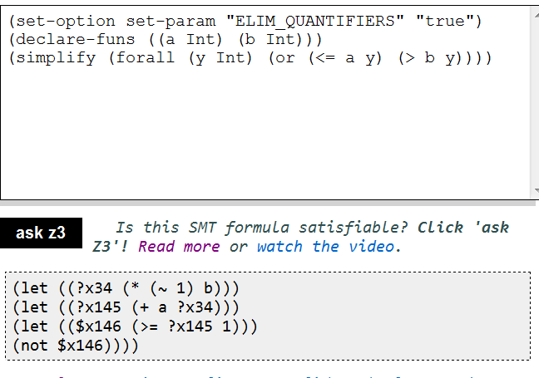
Interaction
Logical Formula
Quantifier
Elimination

Slide 49
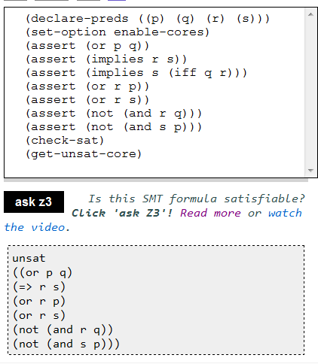
Interaction
Logical Formula
Unsat. Core

Slide 50
Soft constraints
Yices (and more recently a variation of Z3) have support for soft constraints
(define-type uri)
(define relatedProject (::-> uri uri bool))
(define PASO-107::uri)
(define PASO—107b::uri)
. . .
(assert+ (relatedProject PASO-47 PASO-33) 163840)
(assert+ (relatedProjectIs PASO-76 PASO-21) 32768)
. . .
(max-sat)
Weighted Assertions
Sat
. . .
(= PASO-47 1)
(= PASO-33 2)
. . .
(= (relatedProject 7 2) true)
Cost: 687446
Search for model of maximal weight

Slide 51
Main applications

Slide 52
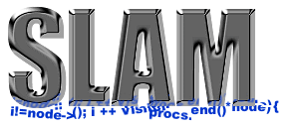


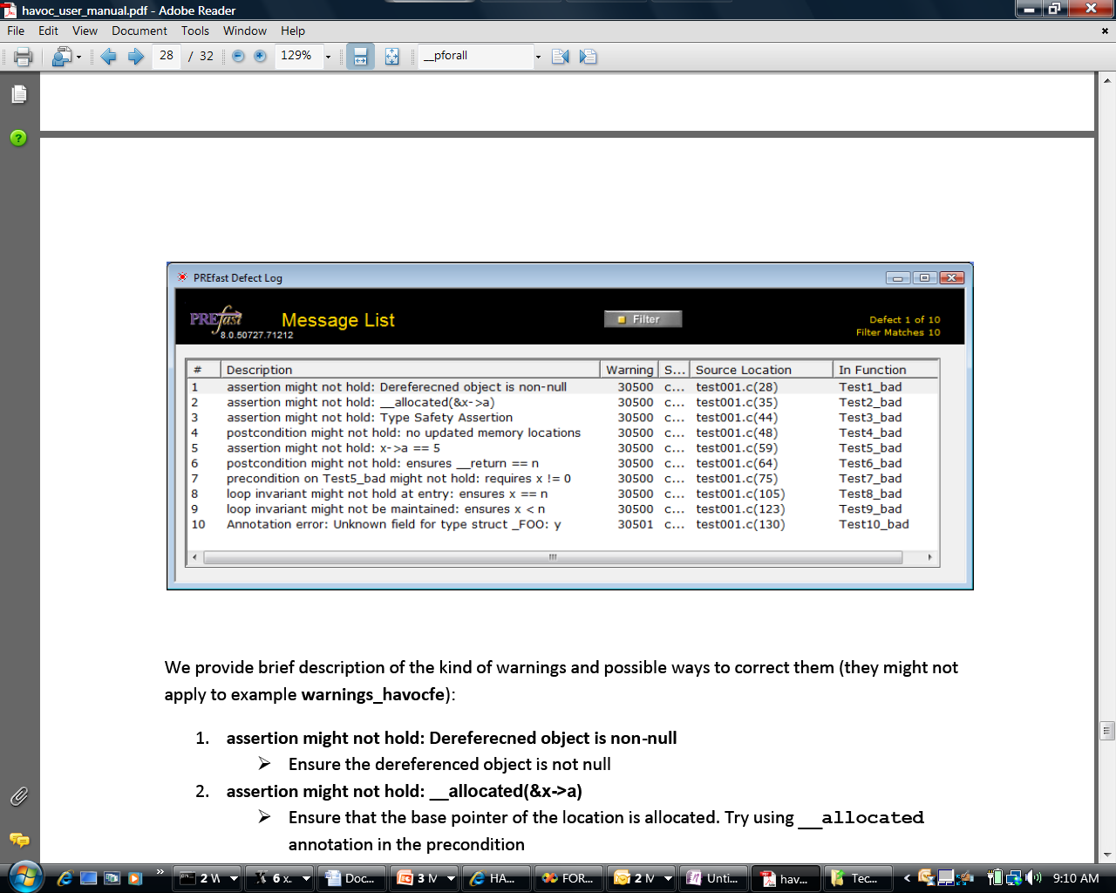
Some Microsoft Engines using Z3
SDV: The Static Driver Verifier
PREfix: The Static Analysis Engine for C/C++.
Pex: Program EXploration for .NET.
SAGE: Scalable Automated Guided Execution
Spec#: C# + contracts
VCC: Verifying C Compiler for the Viridian Hyper-Visor
HAVOC: Heap-Aware Verification of C-code.
SpecExplorer: Model-based testing of protocol specs.
Yogi: Dynamic symbolic execution + abstraction.
FORMULA: Model-based Design
F7: Refinement types for security protocols
Rex: Regular Expressions and formal languages
VS3: Abstract interpretation and Synthesis
VERVE: Verified operating system
FINE: Proof carrying certified code

Slide 53
Main Applications
Test case generation
Verifying Compilers
Predicate Abstraction
Invariant Generation
Type Checking
Model Based Testing

Slide 54
Test case generation
unsigned GCD(x, y) {
requires(y > 0);
while (true) {
unsigned m = x % y;
if (m == 0) return y;
x = y;
y = m;
}
}
(y₀ > 0) and
(m₀ = x₀ % y₀) and
not (m₀ = 0) and
(x₁ = y₀) and
(y₁ = m₀) and
(m₁ = x₁ % y₁) and
(m₁ = 0)
x₀ = 2
y₀ = 4
m₀ = 2
x₁ = 4
y₁ = 2
m₁ = 0
SSA
Solver
We want a trace where the loop is executed twice.

Slide 55
PEX ↔ Z3
Rich Combination
Linear Arithmetic
Bitvectors
Arrays
Models
∀-Quantifier
API
Huge number of small problems. Textual interface is too inefficient.
Used to model custom theories (e.g., .NET type system)
Model used as test inputs
Free
Functions

Slide 56
Type checking
Signature:
div : int, { x : int | x ≠ 0 } → int
Subtype
Call site:
if a ≤ 1 and a ≤ b then
return div(a, b)
Verification condition
a ≤ 1 and a ≤ b implies b ≠ 0

Slide 57
Summary

Slide 58
When to use SMT solvers
To discharge basic theorems automatically
Larger search problems:
Integration with SAT solver cores enable modern, efficient search algorithms.
When your problem uses common theories: Arithmetic, Arrays, Data-types, bit-vectors.
Mostly ground, but with some support for quantifiers:
Quantifier methods by instantiation tuned for program verification problems

